Slide 1
Wireless and mobile computing
Networks fundamentals

Slide 2

How to connect two or more clients for sending and receiving data?
A question ?

Slide 3
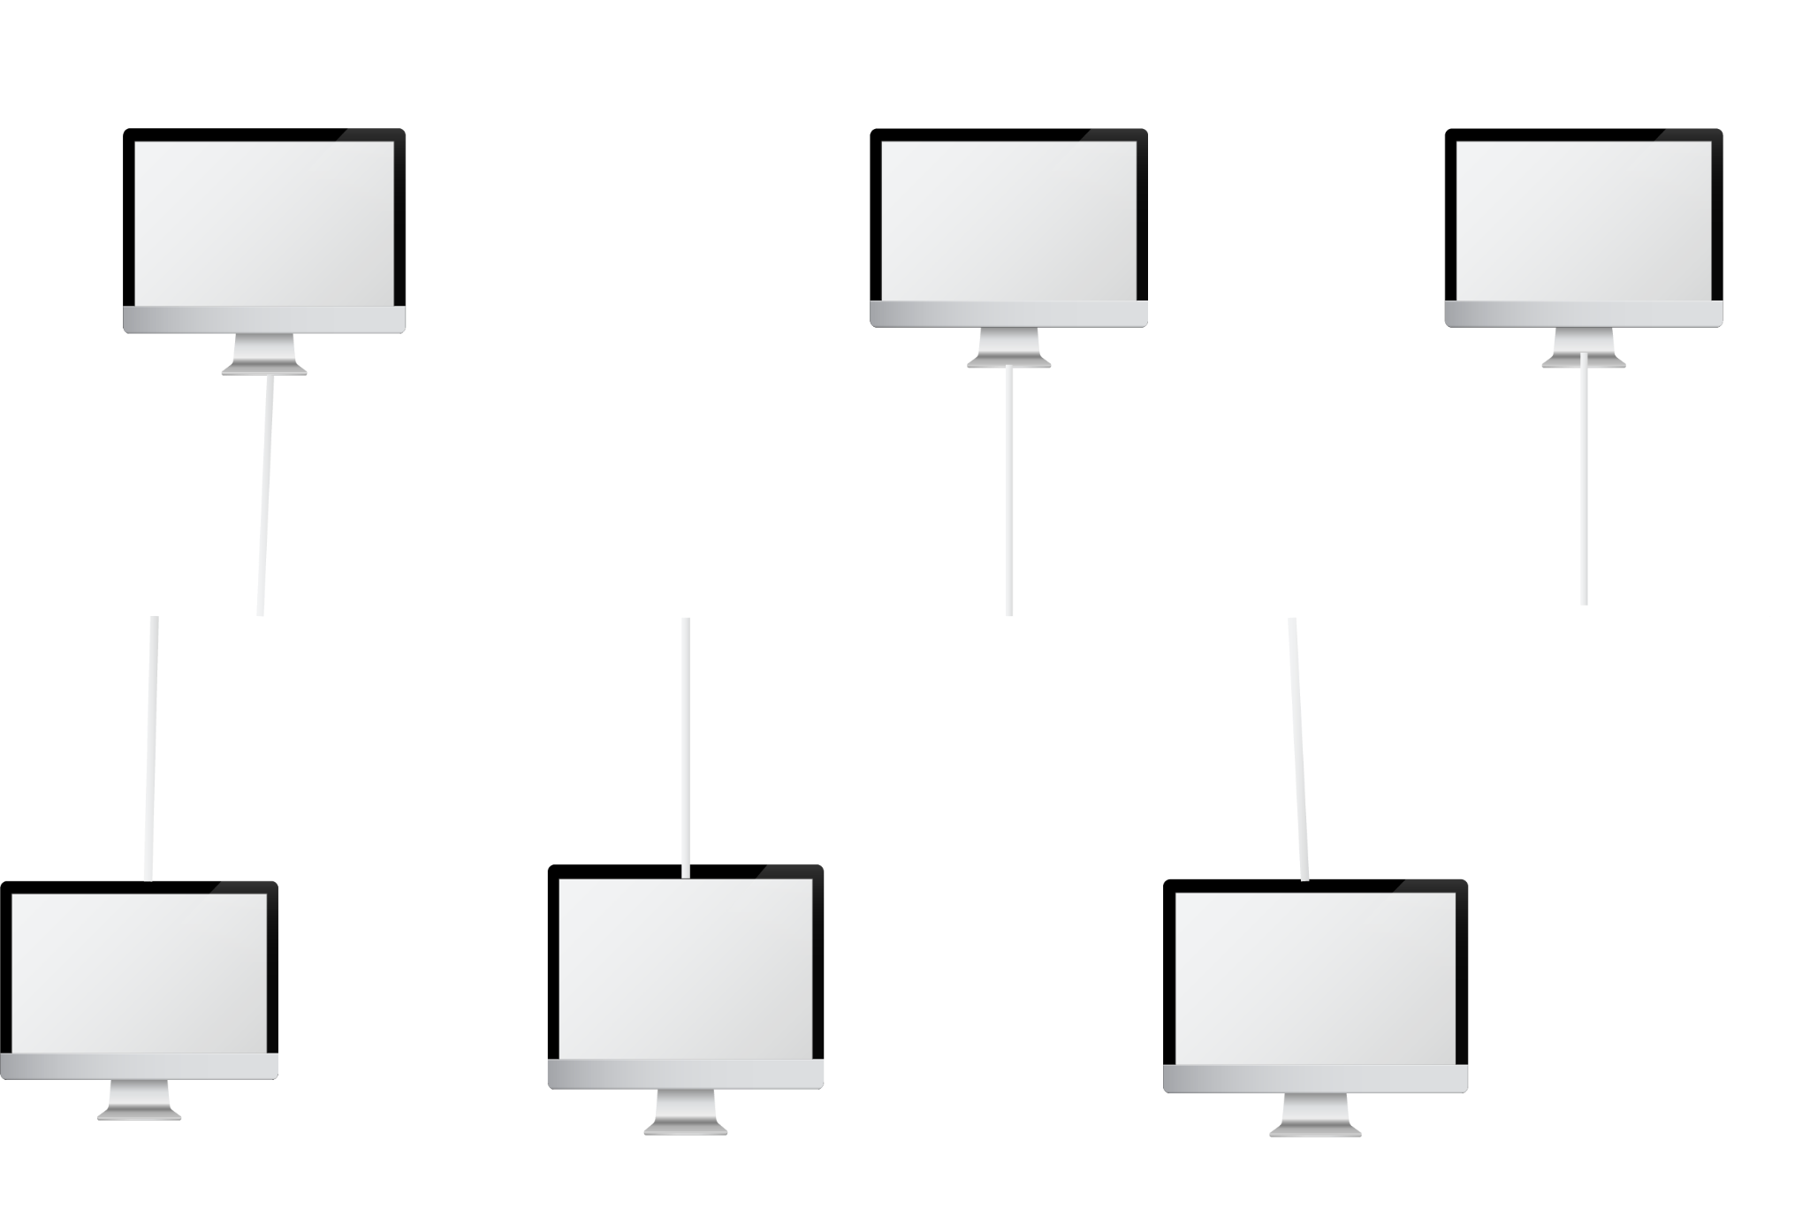
We can just connect them physically with a wire! (Bus Topology)

Slide 4
Drawbacks of Bus topology
Podcasting to every single device into the network
May cause collision if two devices try to communicate at the same time on the main cable
Is not great for large network
very slow

Slide 5
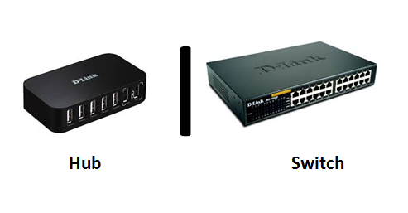
Other approach
Is to use a centralized device

Slide 6
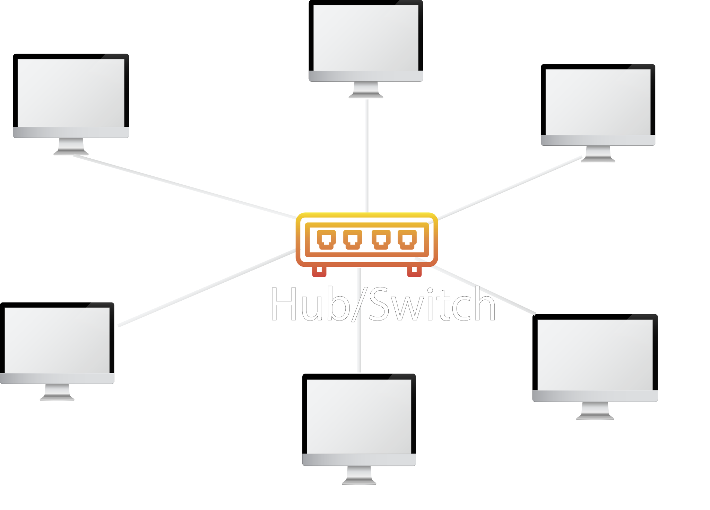
Hubs/Switch

Slide 7
What is a Hub
Hubs provide a dedicated physical connection for every device.
Hub is a shared bandwidth device.
Doesn’t help in the performance of the network
Hubs are essentially multiport repeaters.

Slide 8
What is a Switch
Switches are computer networking device to connect multiple devices together into single computer network.
Switches greatly improve network performance compared to hubs.
By providing dedicated bandwidth to each end device.

Slide 9
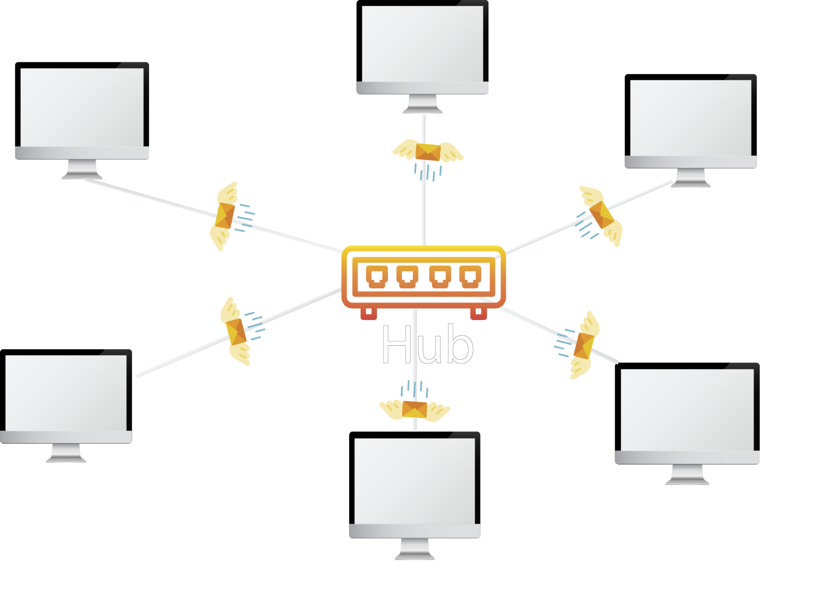
Hubs vs Switches
Transmission type and they works
Hubs
Perform frame flooding
Single collision domain (half-duplex)
Don’t use Mac address table

Slide 10
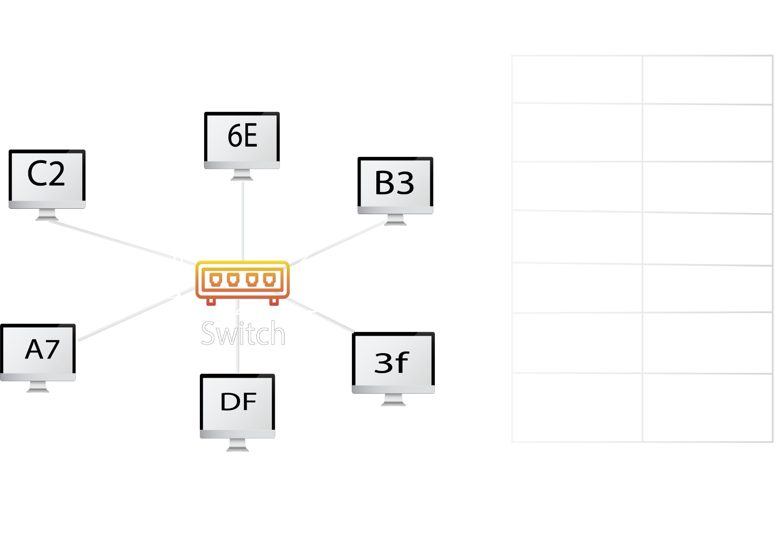
Hubs vs Switches (Cont.)
Transmission type and how they works
Switches
Keep track of MAC addresses
No collisions occur (full-duplex)

Slide 11
Hubs vs Switches (Cont.)
Physical layer
Half-duplex
6-12 ports
10 mbps
Electric signal and Bits
Data Link layer
Full-duplex
24-48 ports
10-100-100 mbps
Packets and Frame

Slide 12
Addressing Types
MAC Addresses (Physical Address)
IP Addresses(Logical Address)
Port Address

Slide 13

MAC Addresses
MAC addresses are sometimes called physical addresses.
they are 48 bit long and consist of 6 blocks of 2 hexadecimal digits 4 bits each.

Slide 14
IP Addresses
IP addresses, or as they’re also sometimes called logical addresses
IPv4 addresses are 32 bit long and consist of 4 so-called octets of 8 bits separated by ‘.’s.
For example,
208.80.152.201

Slide 15
Port Address
The Port number is 16 bits numbers from 0 to 1023.
For example,
80 for HTTP, 123 for NTP, 67 and 68 for DHCP traffic etc.

Slide 16


Thanks for your attention
Questions ?

